Slide 1


Department of Computer science and Engineering
Batch Number – 19PB22
Mini project
On
Fitness Tracker Website
Submitted by
G Harsha vardhan - 19P61A0566
G Harsha vardhan Rao - 19P61A0575
S Harshith - 19P61A0581
Under the Guidance of
Supervisor Name - Mr. G Anil Kumar
Coordinator Name - Dr. G Srikanth Reddy

Slide 2
OUTLINE
PROBLEM STATEMENT
OBJECTIVE
AIM OF THE PROJECT
EXISTING SYSTEM
PROPOSED SYSTEM
SCOPE OF THE PROJECT
SOFTWARE & HARDWARE REQUIREMENTS
UML DIAGRAMS
METHODOLOGY
DESIGN ANALYSIS (USER END/FRONT END)
VIEW OF WEBSITE AND RESULTS
REFERENCES
CONCLUSION & FUTURE WORK
THANK YOU

Slide 3
Problem Statement
People are becoming more and more health-conscious, but they don’t find enough time to go to a gym dedicatedly. This is why health apps and fitness tracking apps are preferred by working people all around the world. There is a lot of content available on the internet about everything. Sadly, as the internet is available everywhere and to everyone, it is subjected to have incorrect information as well.
The same goes for health and fitness information available on the internet. It has become difficult to differentiate between the facts and myths. People were not aware of what is right and what is wrong.

Slide 4
OBJECTIVE
There is a need to study and make a system which will make it easy for an end users to go through the fitness app contents and know more about calorific science and be healthy.To provide clear and easy to understand information To allow the user to download the diet plan To make the app user friendly
The Fitness Center is a health, recreational, and social facility geared towards exercise, sports, and other physical activities.
Increasing your physical activity helps prevent cardiovascular disease and other common health hazards. Health clubs are an effective way to add variety to your routine.

Slide 5
AIM OF THE PROJECT
This project is aimed in developing “FITNESS TRACKER WEBSITE”.
FITNESS TRACKER CARE is a website that looks around the nutrition and wellness of the users. Users can visit the website and check for the calorific science and much more nutritional information.
Because of the increased stress and indulging into unhealthy food habits, people are suffering from obesity and various diseases at very younger ages. People are unaware of the calorific and nutritional sciences.
So, Our Main Aim is to help out everyone reaching out to our website for any possible information regarding to wellness .

Slide 6
Existing system
Smartphones and apps have revolutionized fitness training. The days when average consumers only got a training plan in the gym are long gone.
Nine percent of all apps on offer are now fitness apps. And they're more popular than ever. The companies initially tried to make a profit with training equipment that matched their app.

Slide 7
Proposed system
The proposed system of Fitness Tracker website is that it calculates the BMI of users based on their input height and weight.
It also calculates number of grams of calories micro and macro nutrients a person should take according to their age height and weight.
It also enables a user to know about the food intake in foodchart.
Our website has a calorie counter and daily calorie profile .
We will also add recipes and macro , micro nutrient profile .

Slide 8
SCOPE OF THE PROJECT
A fitness website is a site that is designed to provide fitness enthusiasts with advice, inspiration, workouts, or nutritional guidance.
Health and wellness sites are designed to provide guidance on general health issues, rather than specifically being focused on fitness.
Topics may include mental health and wellbeing, preventative health measures, immunity-boosting nutritional and lifestyle practices, and natural medicine.
A good medical health site will provide detailed information that is broken down to make it easy for the everyday reader to understand. It should include lots of visual content in the form of graphics and video to achieve this goal.

Slide 9
SOFTWARE REQUIREMENTS
Platform : WINDOWS 10
Front End: HTML, CSS, JAVASCRIPT, BOOTSTRAP(we may use REACTJS in future)
Browser: Google Chrome, Internet Explorer 8.0 and above, Mozilla Firefox etc (any of these)

Slide 10
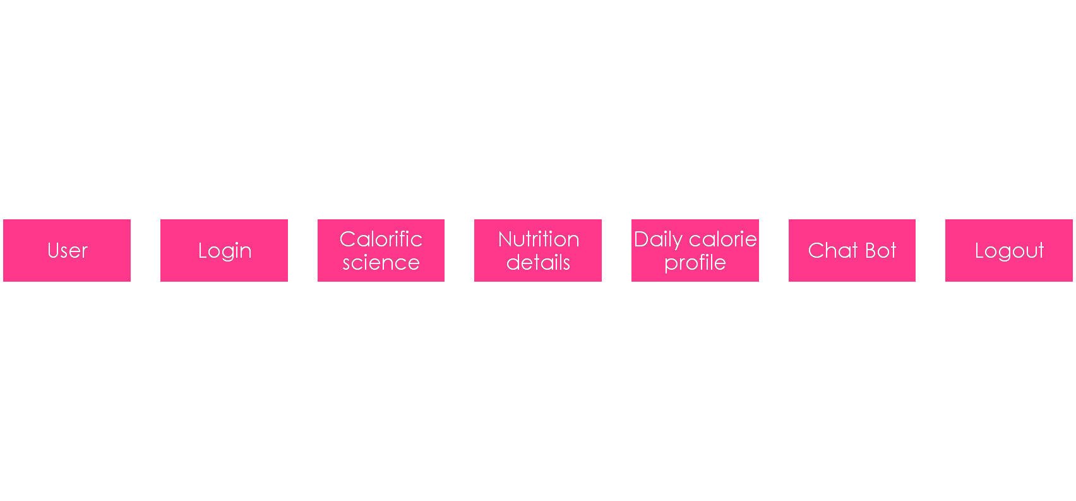
DESIGN ANALYSIS (USER END/FRONT END)

Slide 11
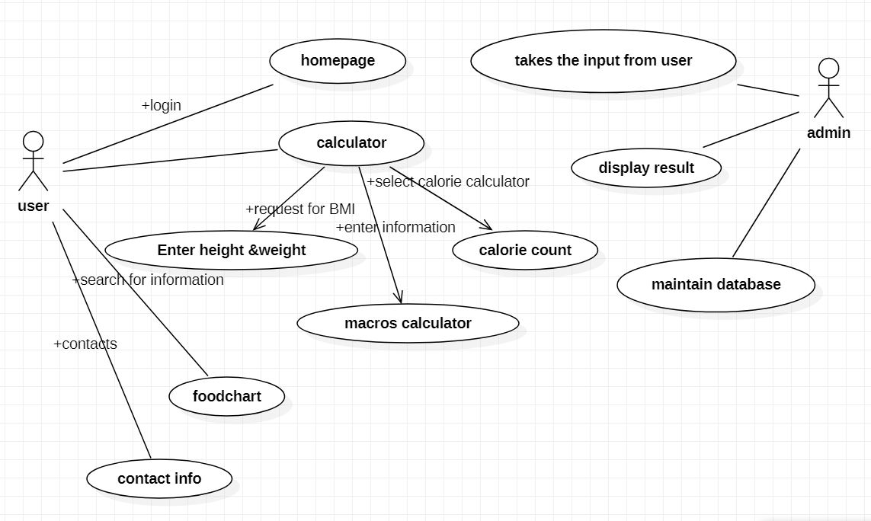
UML DIAGRAMS
USE CASE Diagram

Slide 12
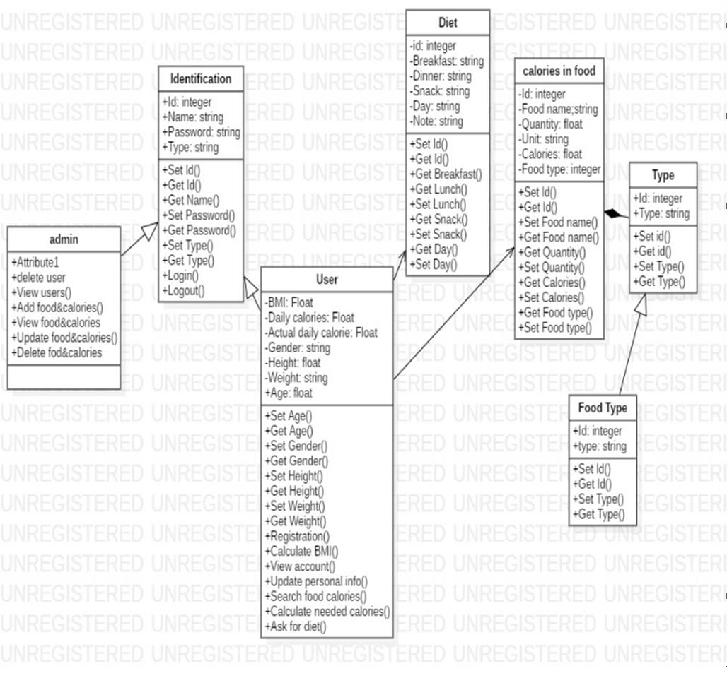
class Diagram

Slide 13
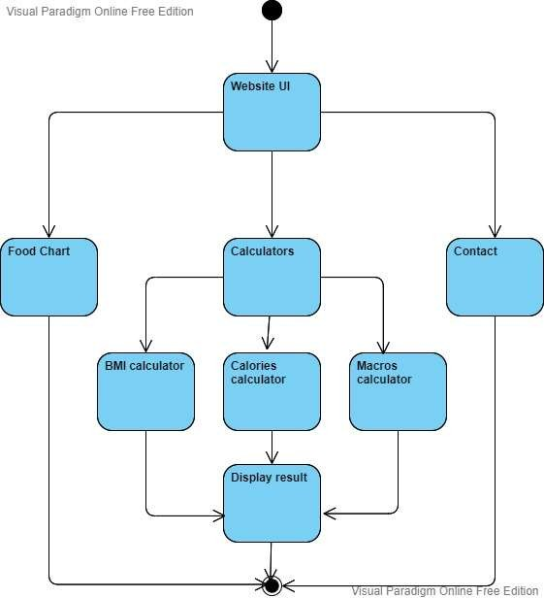
Activity Diagram

Slide 14
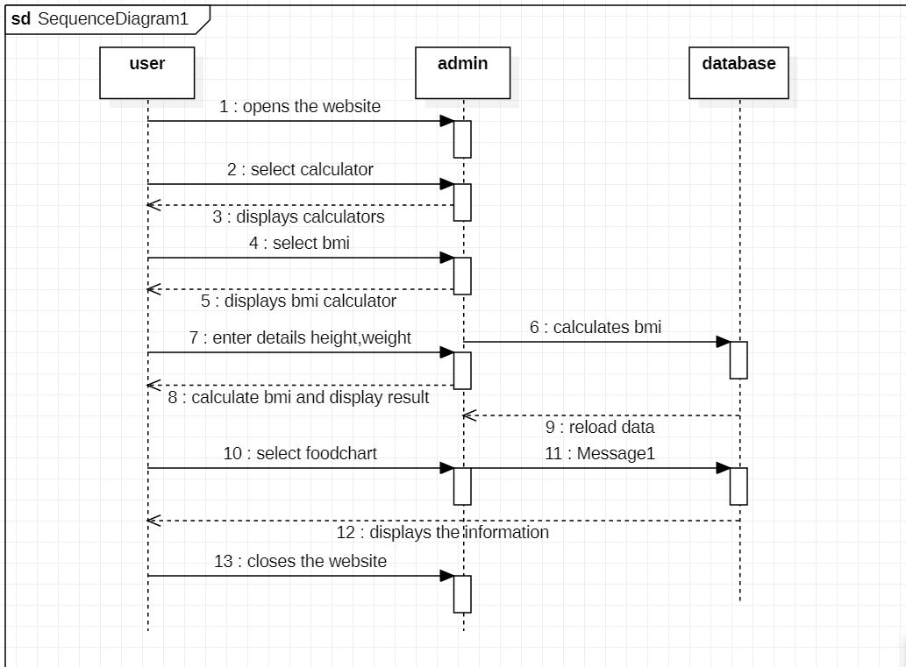
SEQUENCE DIAGRAM

Slide 15
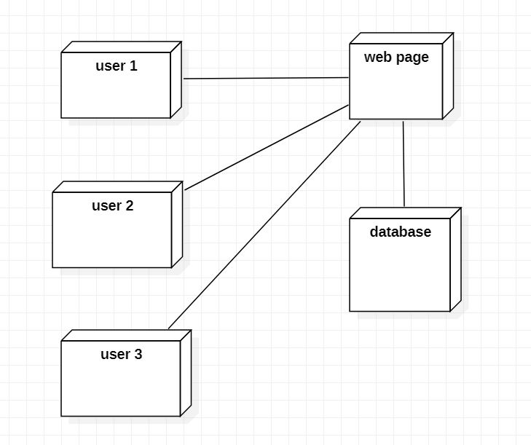
DEPLOYMENT DIAGRAM

Slide 16
METHODOLOGY
For the first time we decided to build/design a website we started making it from scratch using HTML, CSS and a bit of JavaScript.
Our website has a calorie counter and daily calorie profile .
We will also add recipes and macro , micro nutrient profile .

Slide 17
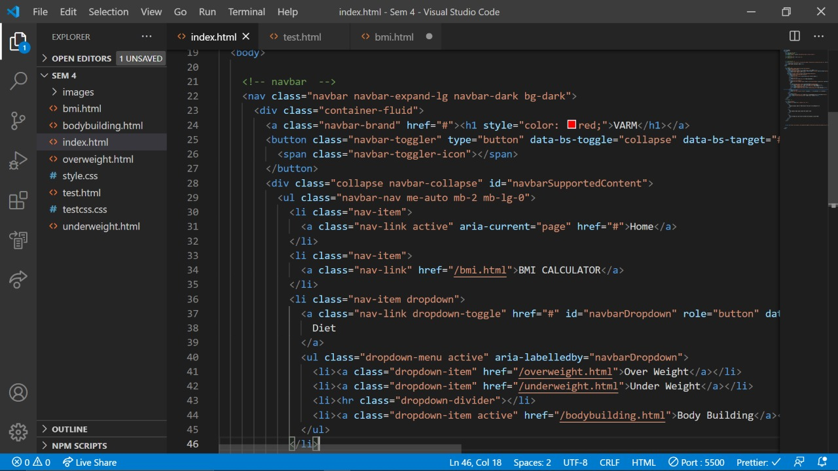
Code outlook

Slide 18
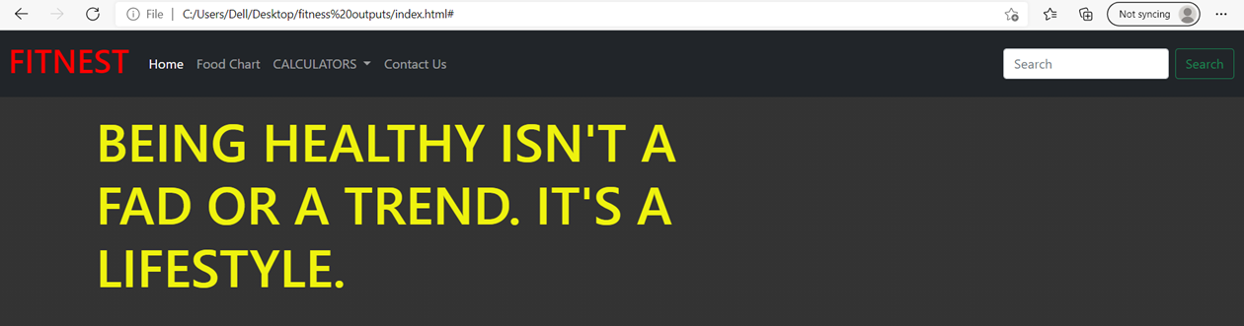
View of website and results

Slide 19
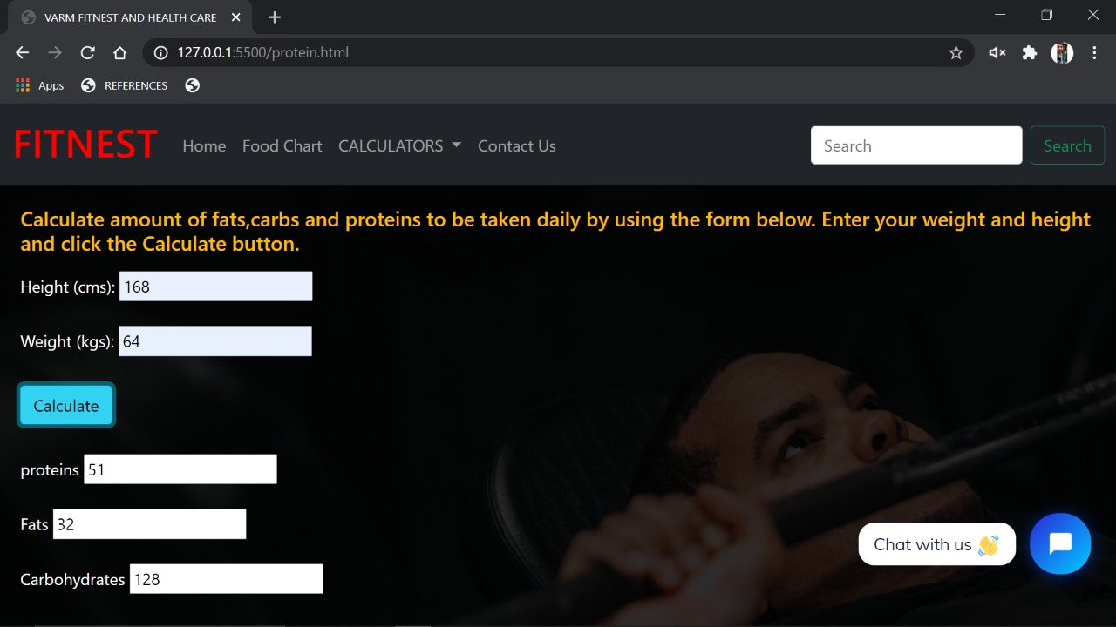
Calculators (bmi , calorie counter, macro calculator)

Slide 20
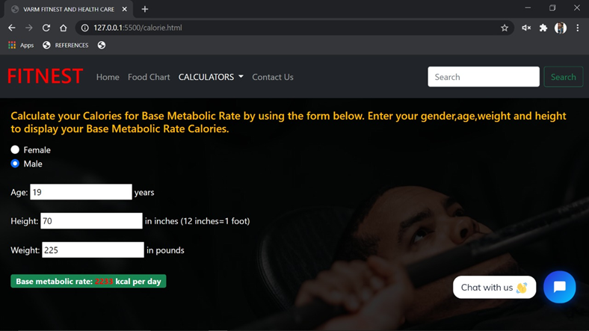

Slide 21
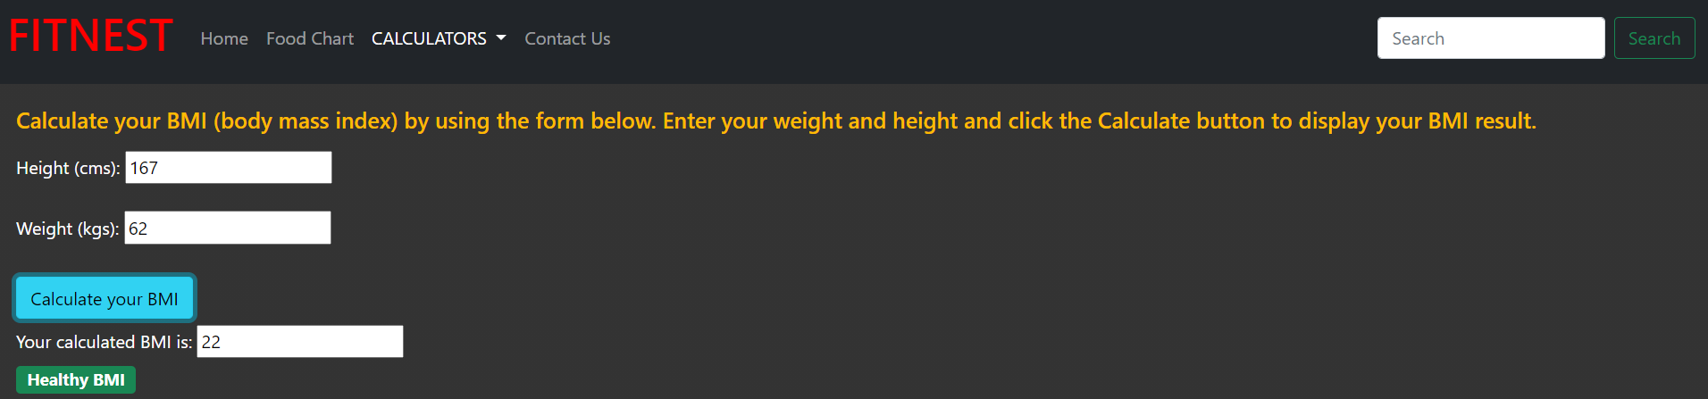
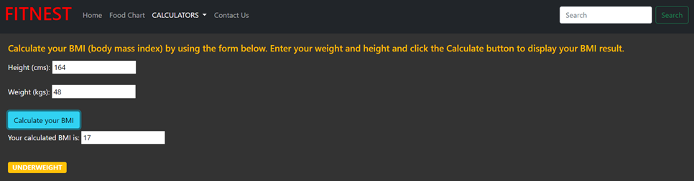

Slide 22
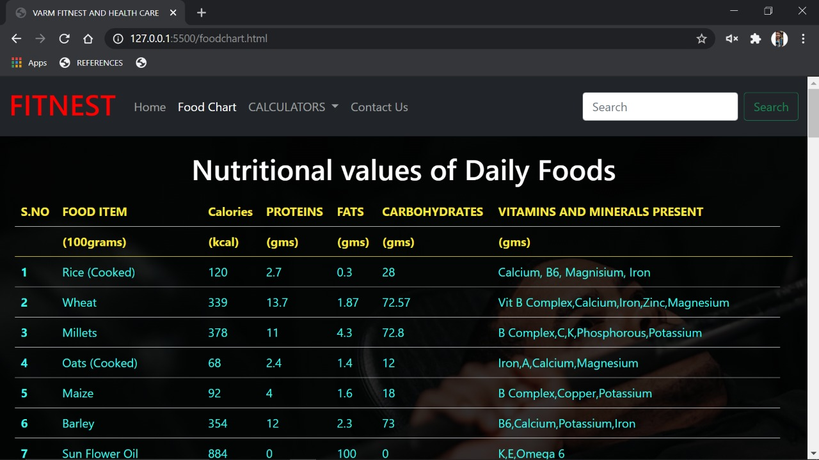

Slide 23
REFERENCES
Refsnes Data, W3schools (HTML, CSS, JAVASCRIPT)
Mark Otto and Jacob Thornton, Aug 2017, Bootstrap 4 Documentation (Bootstrap)
Mosh Hamedani,2020, Codewithmosh (NodeJS)
Eat smart, Move more, Sleep right by Luke Coutinho

Slide 24
CONCLUSION
Being fit has an infinite benefits to your health. It will help you live longer ,it will keep your cardiovascular system functioning without fault even at old age.
As being fit is very much important, we developed a website on fitness health care where one can check their BMI, amount of proteins, calories ,fats and carbohydrates they should consume per day and follow their diet plan accordingly .We have also provided a food chart that has amount of calories ,proteins, carbohydrates contained in different food items. So, one can refer to that food chart and follow the diet plan.

Slide 25
FUTURE WORK
In addition to the current website, we can add a database, where we can collect the information of our users individually, and whenever they enter the website the data will be pre-available to the medic just need to analyze it and give us a report.
Apart from that, we can incorporate machine learning to predict some diseases and health problems that usually occur at a certain age and if fulfill certain conditions we can come to the conclusion that he is most likely to have a health disorder so, he can refer to doctor.

Slide 26


